Slide 1

Welcome to Advanced Java Script
Stage 2 - OOP

Slide 2
Goals of Today
Stack and Heap in JS
Execution Context
Variable Object
Dot Notation vs Bracket Notation
Own vs Prototype Properties

Slide 3
JS is all about Objects

Slide 4
What is Execution Context ?
Execution context is a concept in the language spec that—in layman's terms—roughly equates to the 'environment' a function executes in.
Every execution context has an owner which is the value of this object inside the Execution Context.
The call stack is a collection of execution contexts.

Slide 5
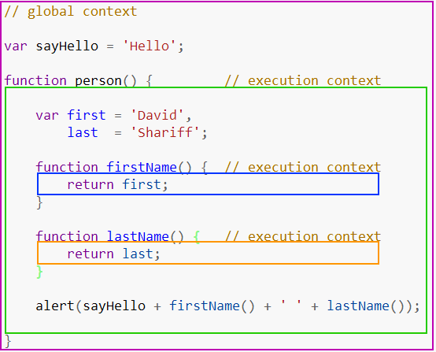
Execution Context

Slide 6
Variable Object

Slide 7
Dot Notation vs Bracket Notation
. vs [ ]

Slide 8
While JS is all about Objects,
Objects are all about Properties

Slide 9
2 Sort of Properties that Objects have
Own Properties
Prototype Properties

Slide 10
(Own vs Prototype) Properties
.hasOwnProperty ( " property name " ) :: boolean
var properties = Object.keys ( object ) ;

Slide 11
_ (Underscore)
_ is used to indicate something private. So don't access it directly.
__ is used to indicate something really.. really... really... private. Generally use by JS engine.

Slide 12
Topics
Stack and Heap in JS
- Execution Context
- Variable Object
- Dot Notation vs Bracket Notation
Properties of Objects
- Own vs Prototype

